Slide 1

Operation: SHADOW BEAR
Location: SOUTH ZARGORIA
UKRAINE
Date: 12 JAN - 16 FEB
Time: 1800 UTC
SECRET: LRG PRIVATE OPERATION (LRGPO)
INFORMATION WITHIN
LRGPO-1201 OPERATION SHADOW BEAR
LRG-NATO BRIEFING
LOCATION
SOUTH ZARGORIA
UKRAINE
Classification: SECRET
Area: UKRAINE

Slide 2
Operation: SHADOW BEAR
Location: SOUTH ZARGORIA
UKRAINE
Date: 12 JAN - 16 FEB
Time: 1800 UTC
SITUATION
Several weeks of civil war within Ukraine has resulted in a complete breakdown of law and order. The fiercest conflict rages along the southern coast, drawing what little loyalist forces remain into the large population centres to battle the increasingly brutal rebels. A large group of bandits and insurgents have used the resulting power vacuum to seize large swathes of the countryside along the Ukrainian/Romanian border.
Despite widespread reports of kidnapping, forced labour and summary executions, the UN security council has been unable to agree any military response. The Russian Federation continue to use their veto to prevent any action citing concerns about the number of NATO troops deployed along its western borders already.
Thousands of refugees have fled across the Romanian border causing a humanitarian crisis. Romania has requested immediate NATO assistance to set up a safe buffer zone inside of Ukraine to slow the tide of human traffic. NATO have decided to take unilateral action and the LRG are being deployed as the first NATO forces to cross the border.
Classification: SECRET
Area: UKRAINE

Slide 3
Operation: SHADOW BEAR
Location: SOUTH ZARGORIA
UKRAINE
Date: 12 JAN - 16 FEB
Time: 1800 UTC
ENEMY FORCES
Ukrainian Insurgents
The majority of enemy forces along the border area are criminals and ex-soldiers, intent on exploiting the current situation for their own financial gain. They are equipped with weapons typical of the region, using mainly AK variants and RPGs. They have possession of several armed vehicles captured from the remaining loyalist forces in this area.
They rely on their brutal methods to intimidate the civilian population into silence. Any who resist are at best sentenced to manual labour or at worst executed.
Classification: SECRET
Area: UKRAINE

Slide 4
Operation: SHADOW BEAR
Location: SOUTH ZARGORIA
UKRAINE
Date: 12 JAN - 16 FEB
Time: 1800 UTC
MISSION
Your overall mission is to restore law and order along the border region, creating a safe zone for civilians fleeing the conflict in the south.
While carrying out this mission you are also expected to;
Prevent further atrocities being committed against the civilian population.
Capture the insurgent hierarchy if possible.
Distribute food and medical supplies to the surrounding areas.
Remain neutral in the ongoing civil war.
Investigation reports of external assistance being provided to rebel forces.
Classification: SECRET
Area: UKRAINE

Slide 5
Operation: SHADOW BEAR
Location: SOUTH ZARGORIA
UKRAINE
Date: 12 JAN - 16 FEB
Time: 1800 UTC
RULES OF ENGAGEMENT
The LRG must abide by the usual Rules of Engagement.
Insurgents are operating in and around civilian population centres. The LRG are expected to conduct any operations within these areas with the utmost regard for civilian life and property.
The LRG is expected to remain neutral in the ongoing civil war and must not engage either loyalist or rebel forces. If engaged by either side the LRG is expected to conduct a fighting withdrawal.
Classification: SECRET
Area: UKRAINE

Slide 6
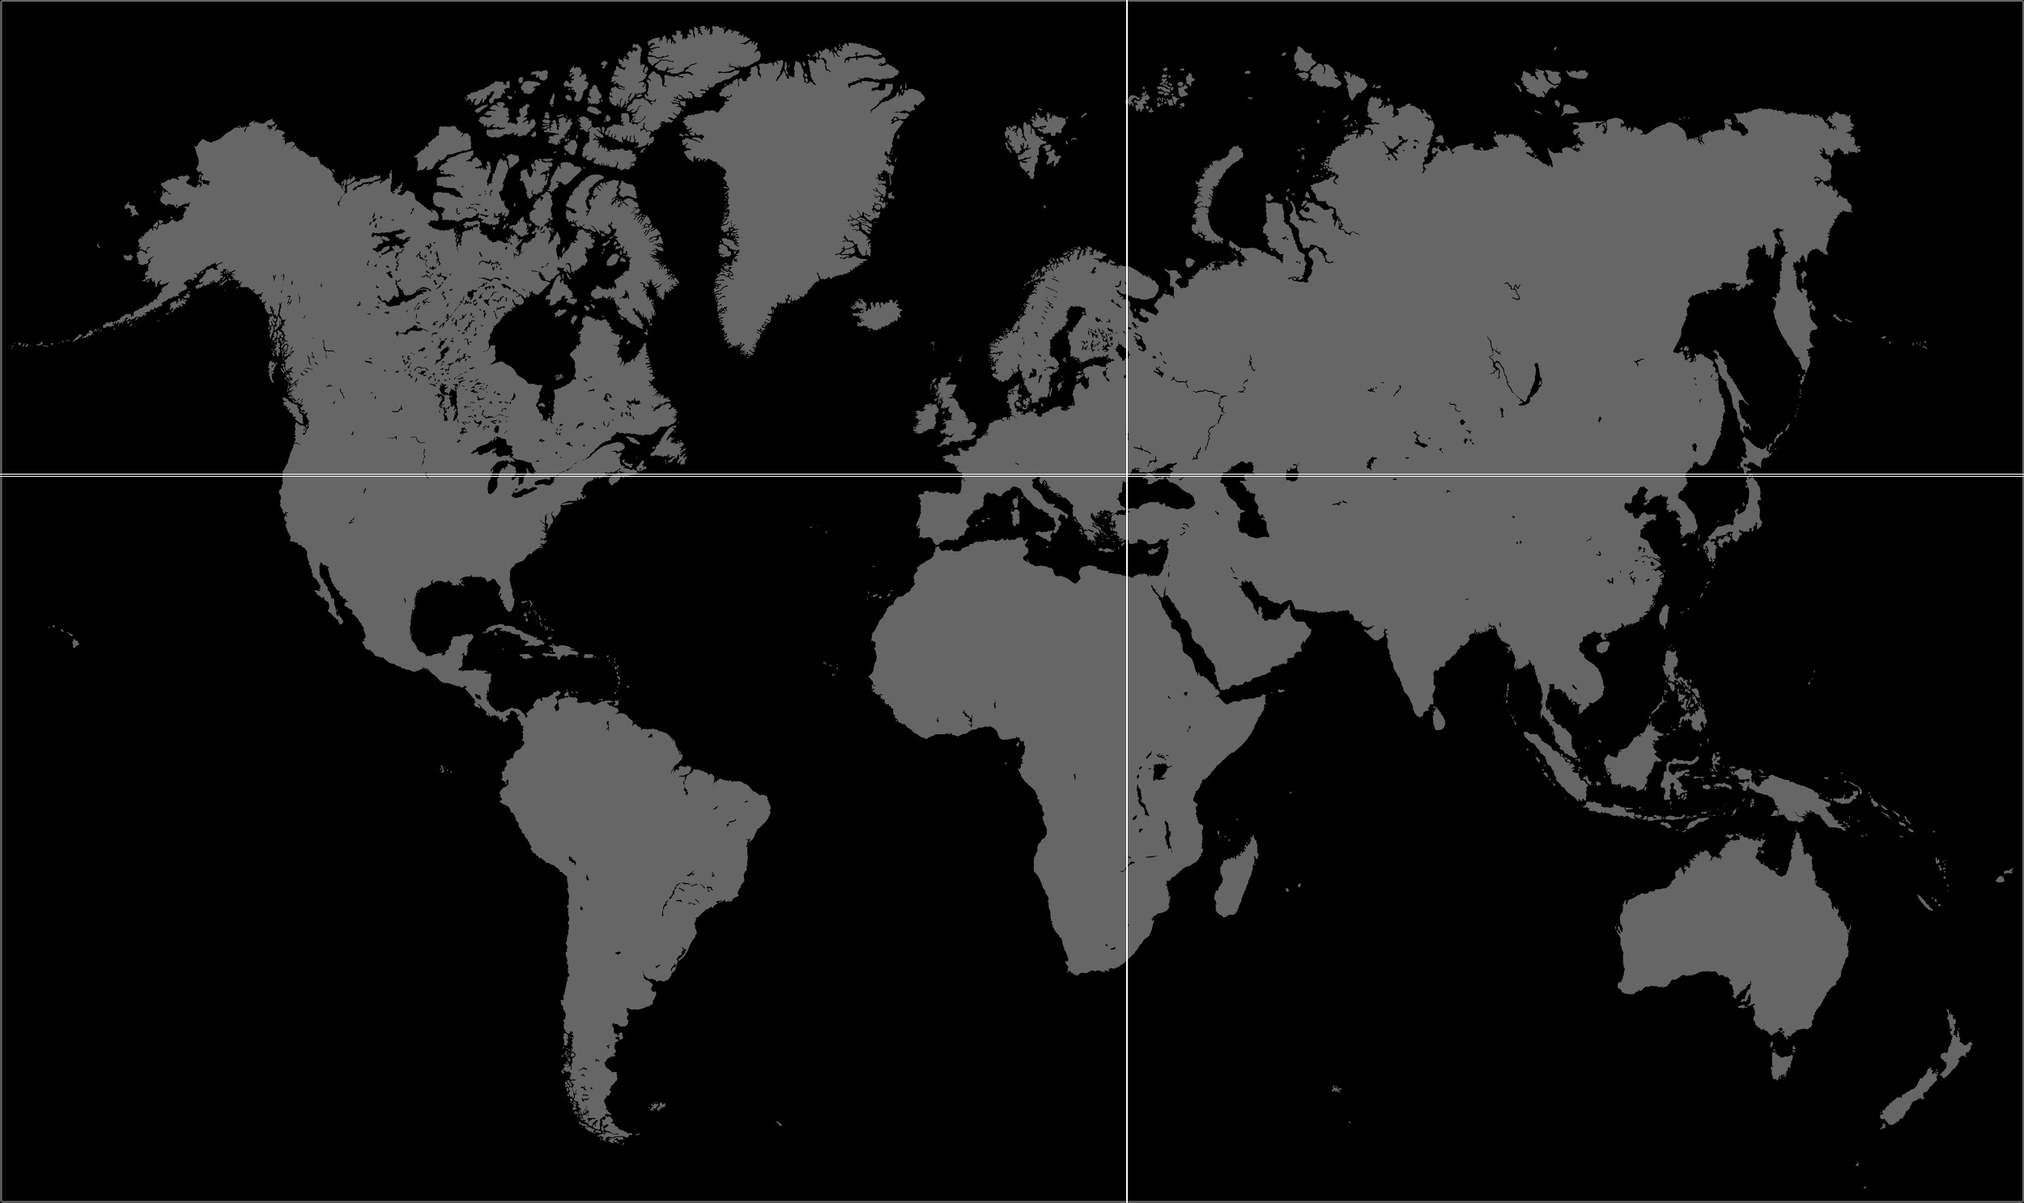
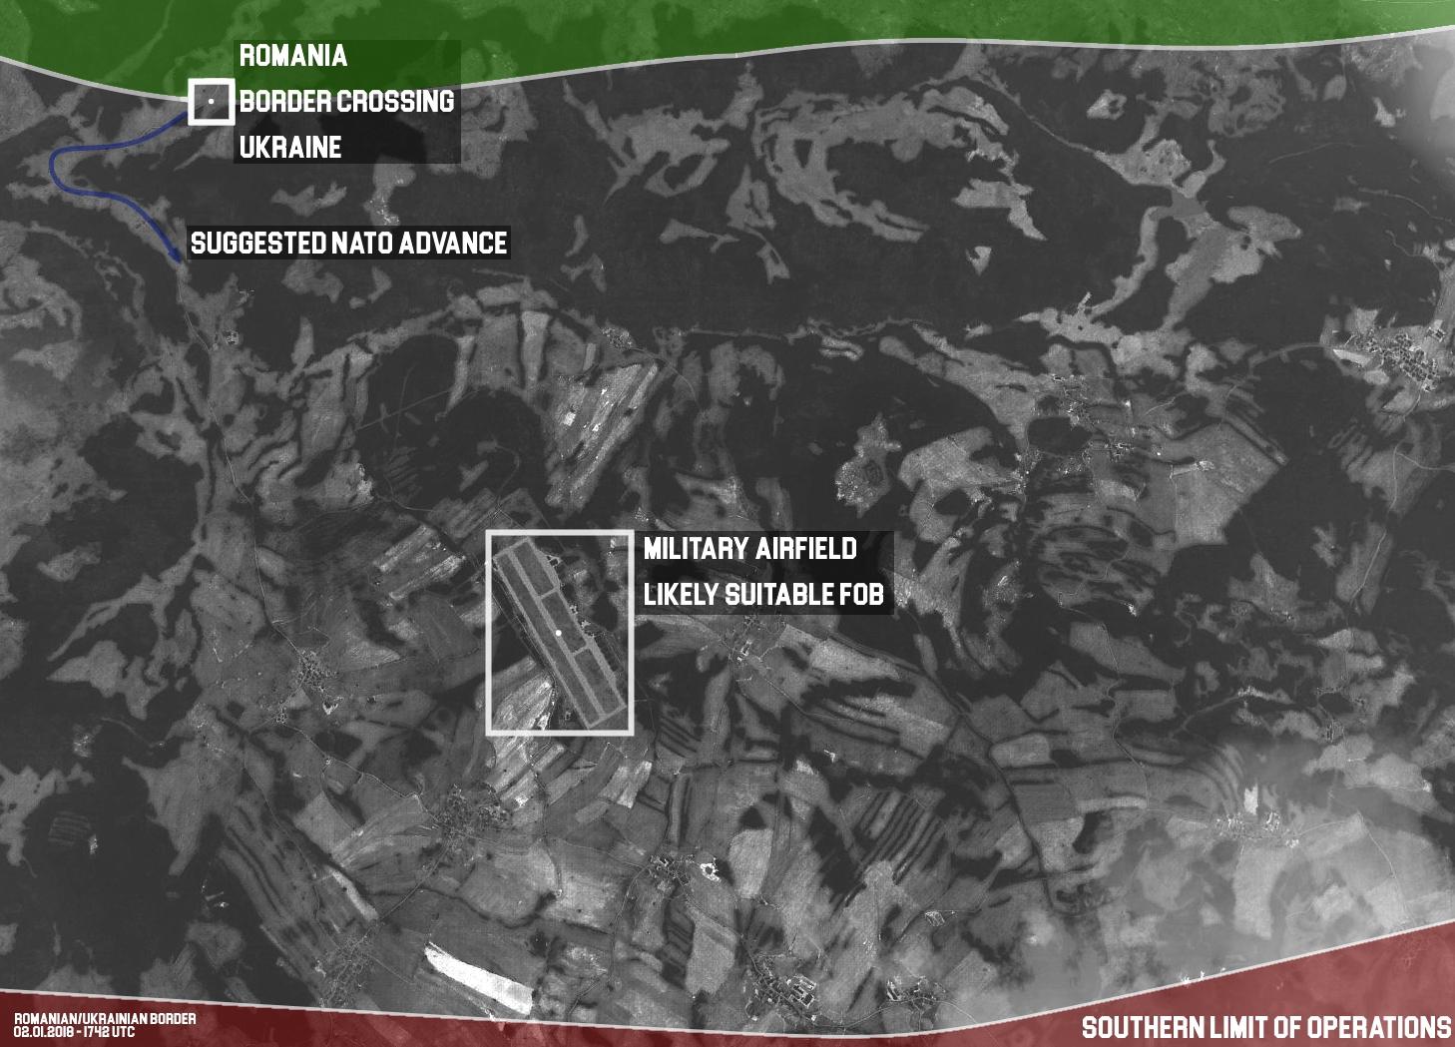
Operation: SHADOW BEAR
Location: SOUTH ZARGORIA
UKRAINE
Date: 12 JAN - 16 FEB
Time: 1800 UTC
AREA OF OPERATIONS
South Zargoria, Ukraine
Classification: SECRET
Area: UKRAINE

Slide 7
Operation: SHADOW BEAR
Location: SOUTH ZARGORIA
UKRAINE
Date: 12 JAN - 16 FEB
Time: 1800 UTC
END OF BRIEF
Classification: SECRET
Area: UKRAINE

